Slide 1
ARTIFICIAL INTELLIGENCE
NAME:RWAN MOHAMED AHMED
ID:323 GROUP:3
SECTION:14 BN:22

Slide 2
APPLICATIONS:
ASTRONOMY
HEALTHCARE
TRANSPORT
EDUCATION
AGRICULTURE
E-COMMERCE
ENTERTAINMENT
ROBOTICS
AUTOMOTIVES
SOCIAL MEDIA

Slide 3
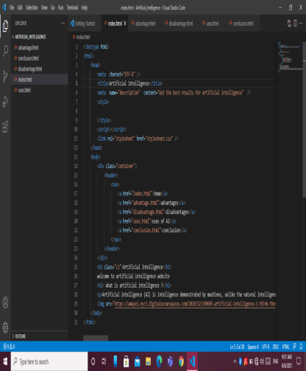
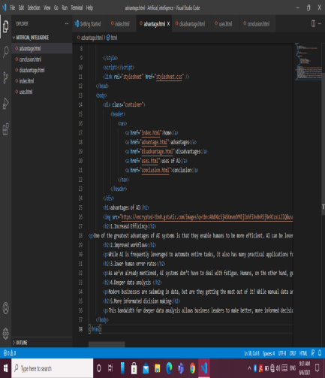
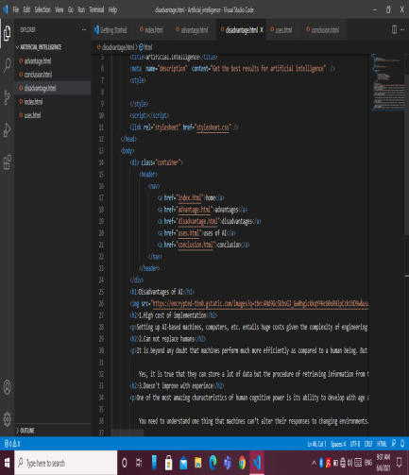
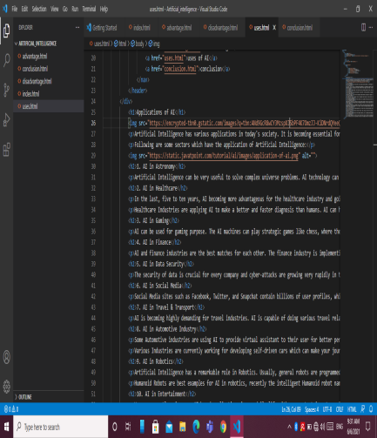
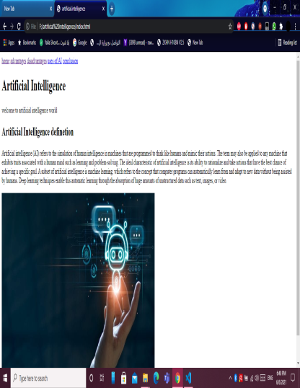
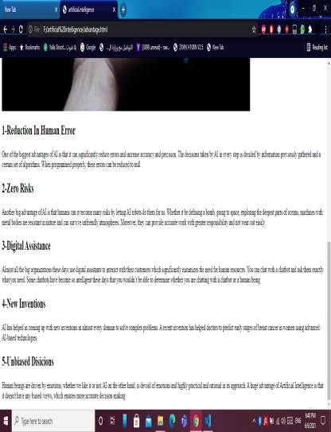
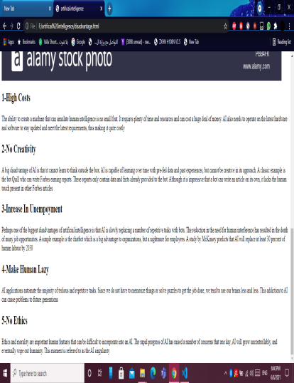
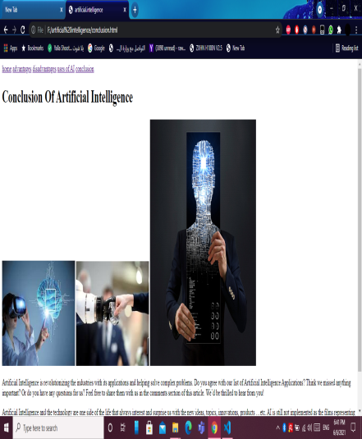
SOURCE CODES:

Slide 4
SOURCE CODES:

Slide 5
LINKS:

